Slide 1
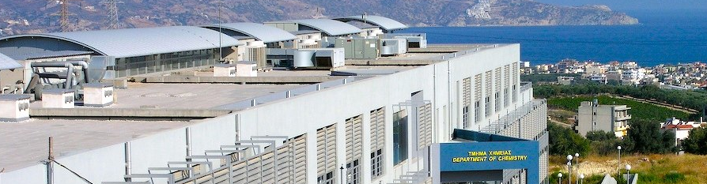

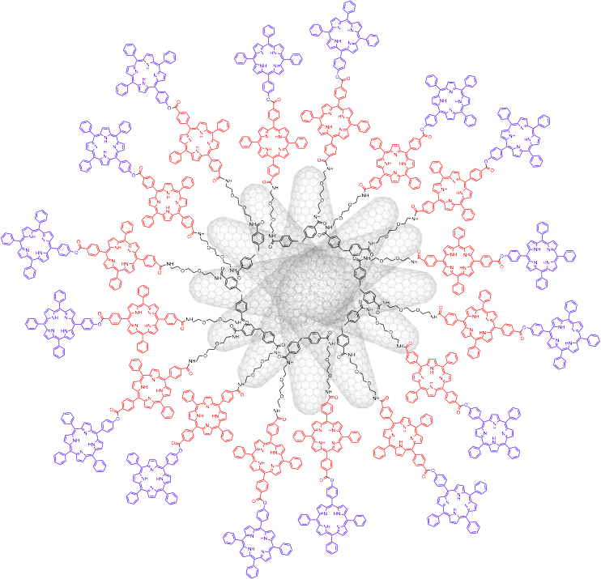



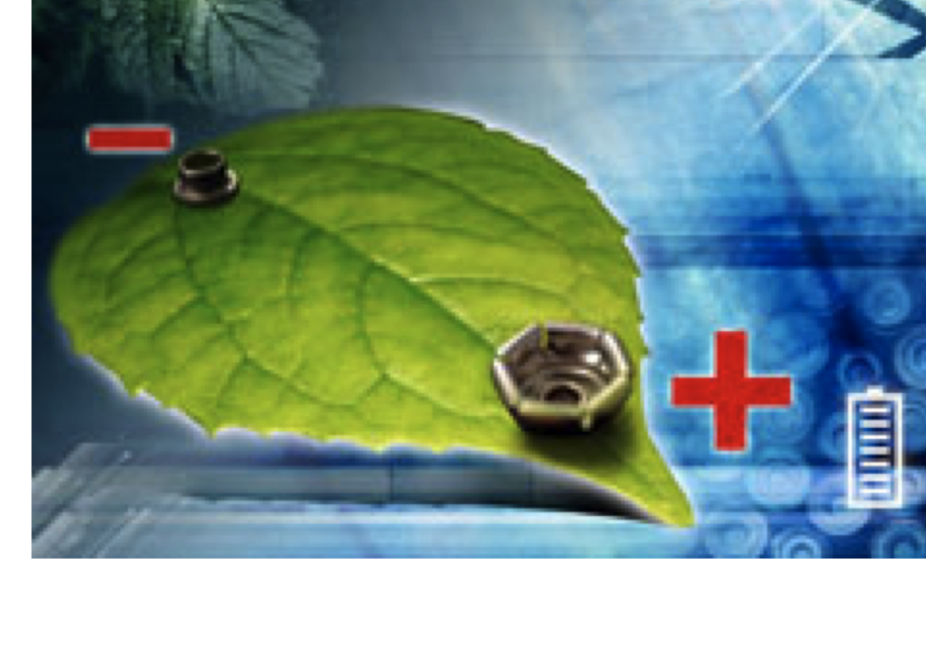


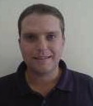
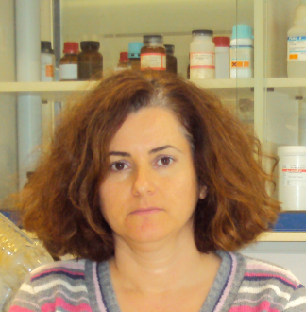
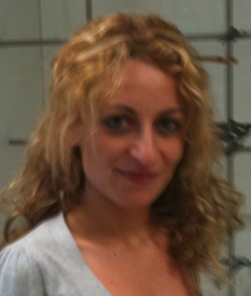
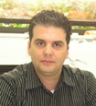
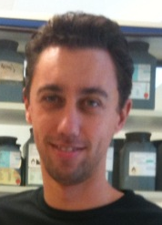
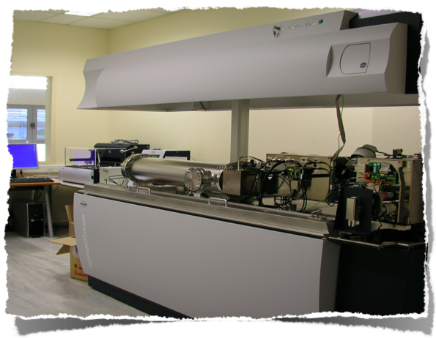
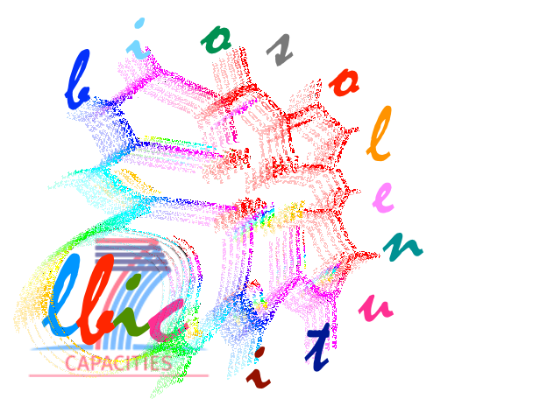

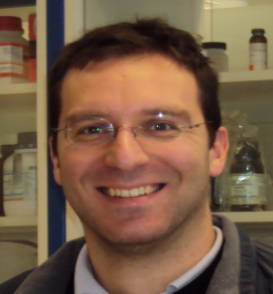
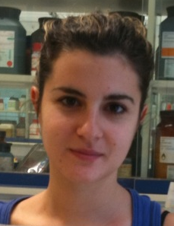
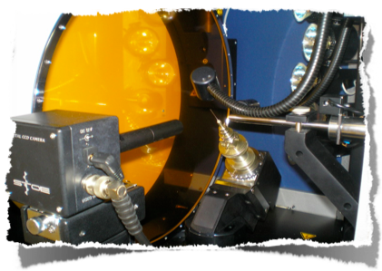
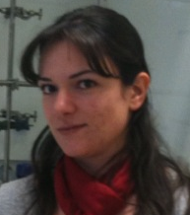
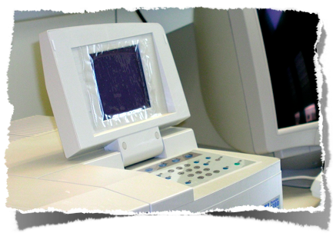
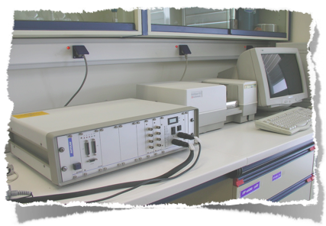
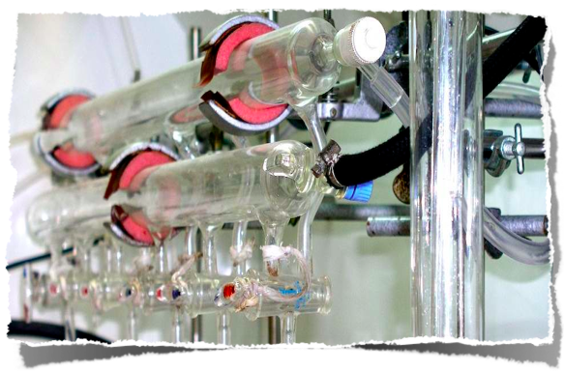

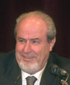
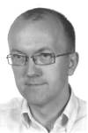
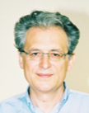
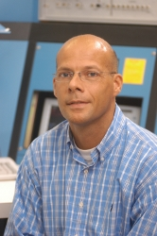
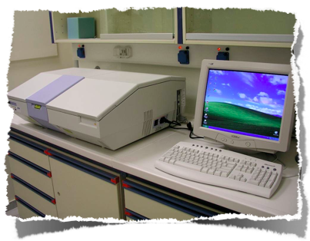
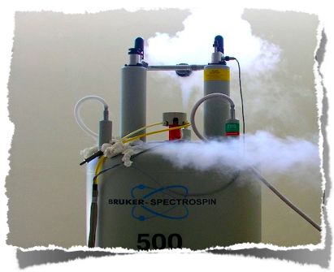


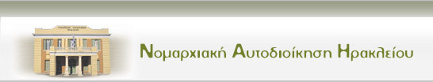

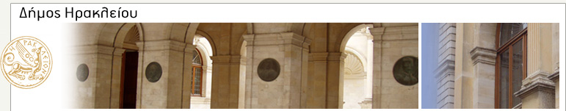
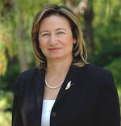

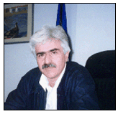

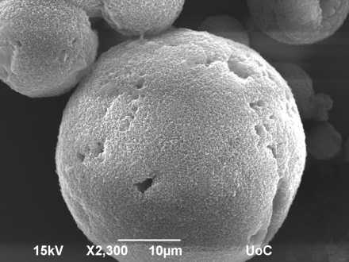
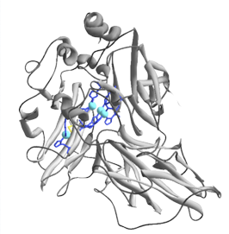
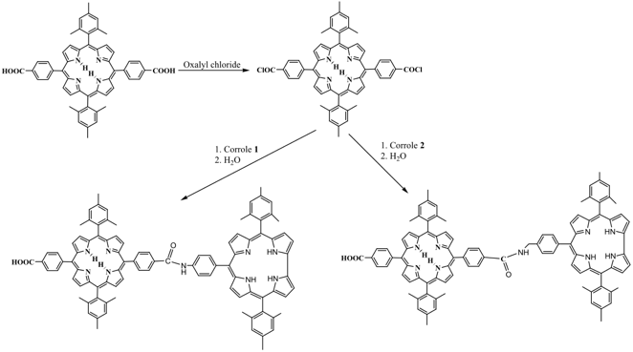
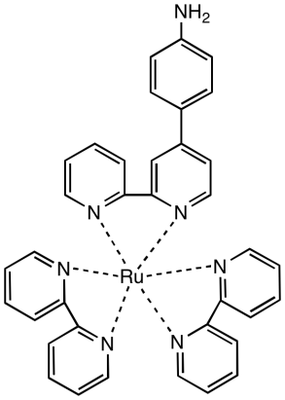
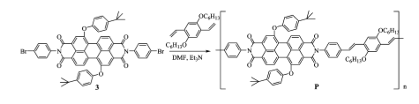
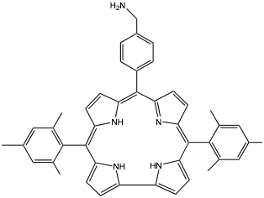
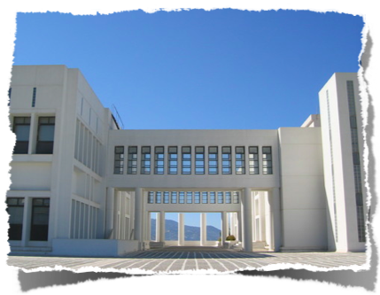
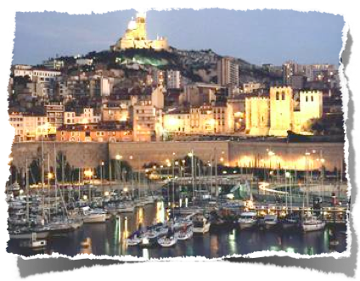
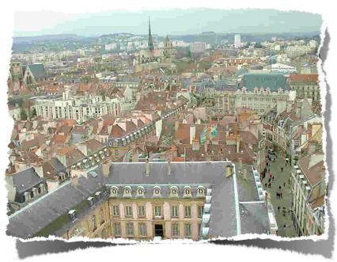
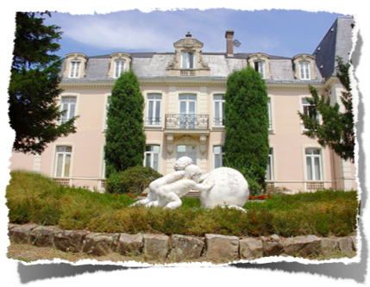
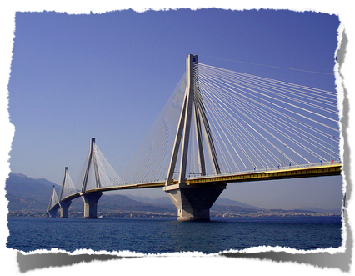
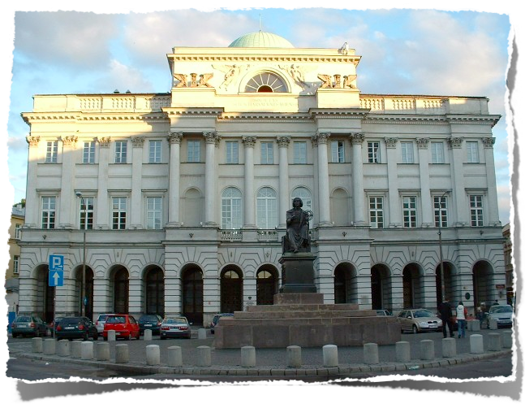



WIRE: Week of Innovative Regions in Europe – Granada, 15th – 17th March 2010
Research Potential
Bioinspired Solar Energy Utilization
M arch 2009 –April 2012
Athanassios G. Coutsolelos
Region of Crete, Greece
FP7-REGPOT-2008-1 No 229927
University of Crete, Chemistry Dept
Laboratory of Bioinorganic Chemistry
PO Box 2208, 71003 Heraklion Crete Greece
Unesco code 2399
objectives
Experience on the subject
Location
-Creativity
Recruitment of experienced researchers
The team of LBIC of the Chemistry Department is enlarged with experienced researchers, recruiting two Nationals and one European.
Exchange of know-how and experiece
Acquisition/upgrade of the scientific equipments
Strengthening of the status of LBIC
  organization of an international conference
  publications, oral communications, dissemination and promotional activities
  creation of a web site
Strenghts
Weaknesses
On time recruitment of talent individuals.
-Many ideas may find difficulties to realize,
lack of both suitable upgraded facilities
and/or new equipments.
Concept of the project:
The target of the proposed BIOSOLENUTI project is the strengthening of the research capacity as well further development of bioinorganic chemistry lab (LBIC or Laboratory of Bioinorganic Chemistry) at the Chemistry Department of the University of Crete. The scientific concept of BIOSOLENUTI project emerges from a request for a bioinspired basic research in revolutionary chemistry for the highly efficient and cost effective production of fuels and electricity by the direct conversion of solar photons. The BIOSOLENUTI project will lead to a substantial development of the LBIC in terms of personnel and equipment but also in terms of a strengthening of the status of LBIC at local (in collaboration with the region of Crete), at national, at European and international level as centre of excellent research and provider of know-how.
Exchange of known-how and experience
-The contribution to the design of new
functional materials
-Increase the contact with problems relatives
for wealth and welfare of society
Opportunities
Threat
- Complementary products
- The public and government contribution and/or participation.
X-Ray diffractometer with cryostat
MALDI-TOF MS with LC was installed 14-12-09
spectroelectrochemistry
Uv-visible
FT-IR
Meeting of the Scientific Committee January 15-16 2010
chromato
NMR
Vacuum line
Presentation of the project to the local community through newspaper articles
Expected Impact
WP 4 International
Conference
municipality
prefecture
WP 2 Materials resources
Upgrade/acquisition
Collaborative Entities:
Prof A. Mitraki
Material Sciences, Crete
Visit at Prof. T. Tron, Marseille, France 22-03-2010
Prof. R. Guilard
Dijon, France
Prof. J.-P.Mahy
Paris Xi, France
Prof. Y. Mikroyiannides
Patras, Greece
Visit at Prof. Daniel Gryko Warsaw, Poland 24-03-2010
ETAM
Consulting services
Laboratory of Bioinorganic Chemistry, Department of Chemistry, University of Crete, PO Box 2208, Voutes, 71003-Heraklion, Crete, Greece. Email: coutsole@chemistry.uoc.gr, Tel.+302810545045,
www.biosolenuti.gr

